Slide 1
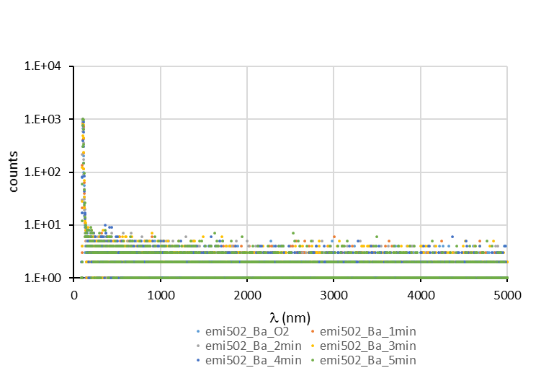
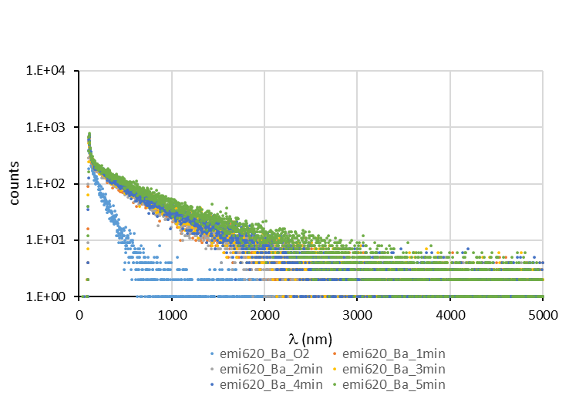
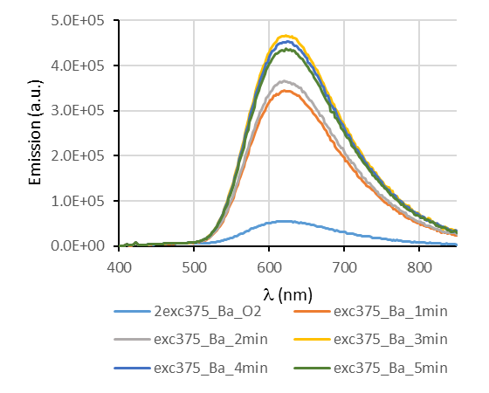
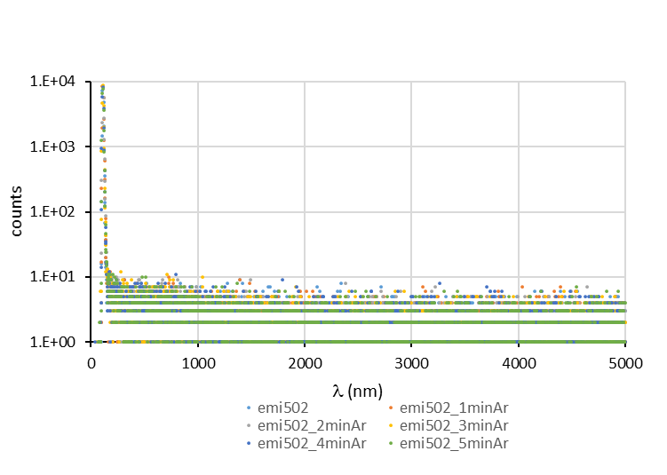
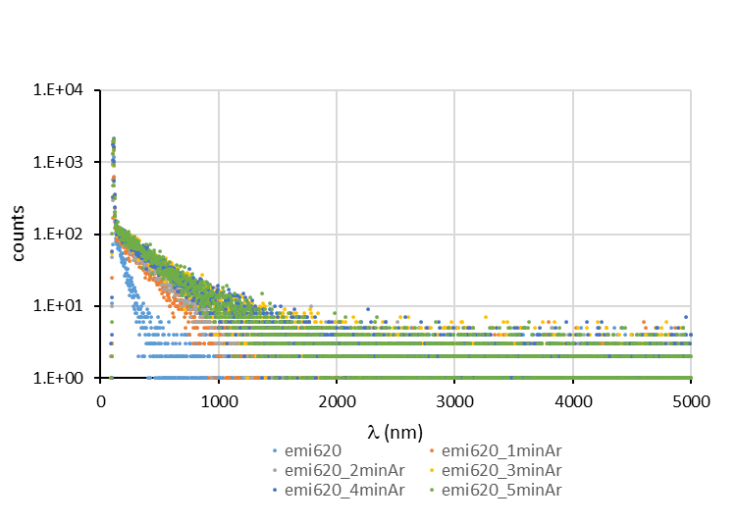
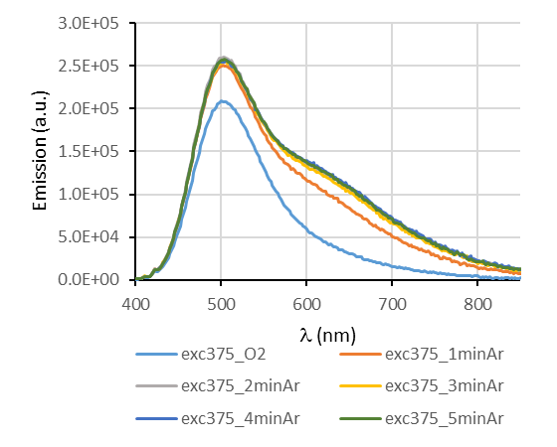
1E-5 M ACN
Study of the effect of degassing time on the emission
AAN155-Ba
AAN155-Ba O2, emi 502 nm
AAN155-Ba O2, emi 620 nm
AAN155 O2, emi 502 nm
AAN155 O2, emi 620 nm
AAN155
ZFFL55_19&20_9_2023
EPL375_TCSPC_50KHz_20ms, 8192channels, 30 min

Slide 2
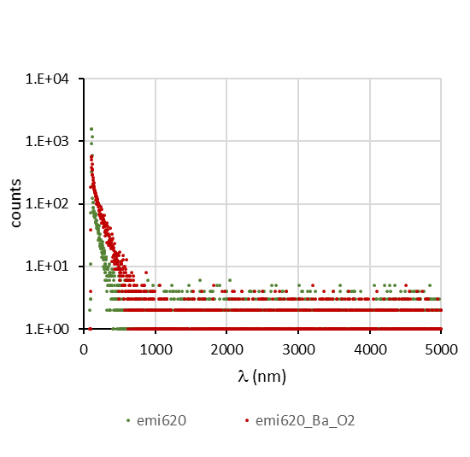
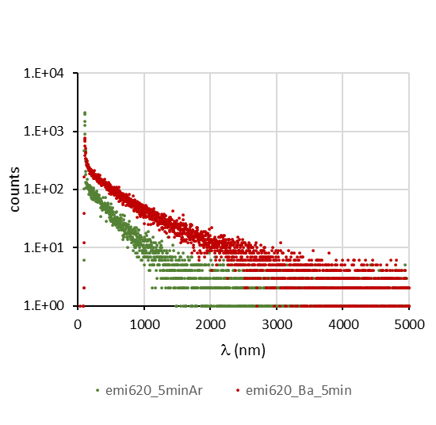
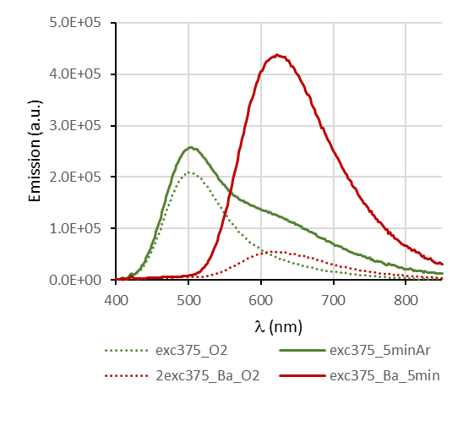
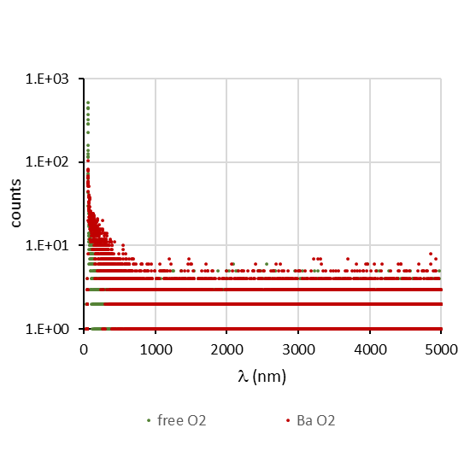
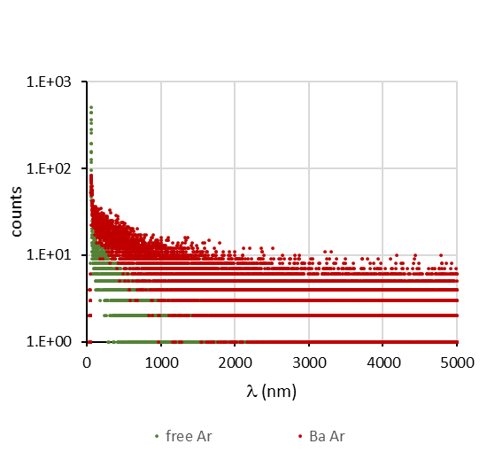
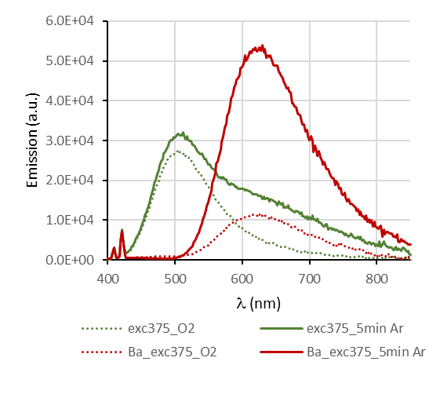
Comparison free-bound under oxygen / 5 min argon
Emission at 620 nm
1E-5 M ACN
oxygen
argon
τ₁ 4 ns (20%)
τ₂ 345 ns (80%)
χ² 0.71
τ₁ 10 ns (4%)
τ₂ 238 ns (25%)
τ₃ 768 ns (71%)
χ² 0.76
oxygen
argon
1E-6 M ACN
τ₁ 3 ns (39%)
τ₂ 238 ns (80%)
χ² 0.79
τ₁ 10 ns (3%)
τ₂ 264 ns (23%)
τ₃ 1036 ns (74%)
χ² 1.11
ZFFL55_19&20_9_2023
ZFFL55 03_10_2023
EPL375_TCSPC_50KHz_20ms, 8192 channels, 30 min

Slide 3
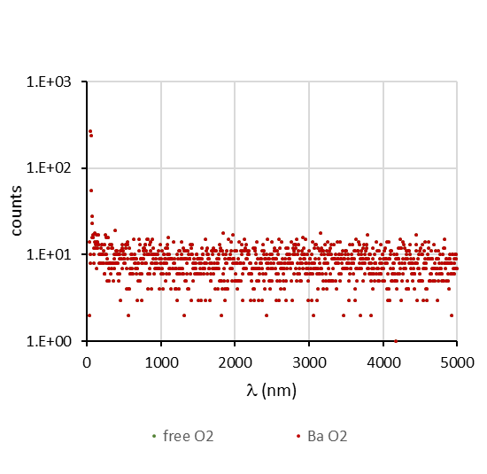
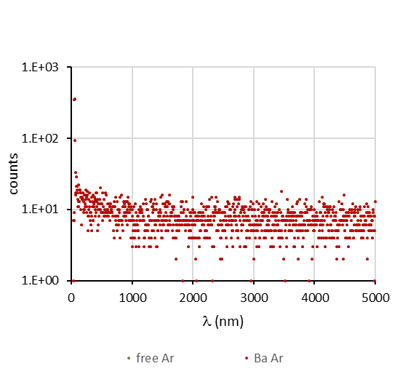
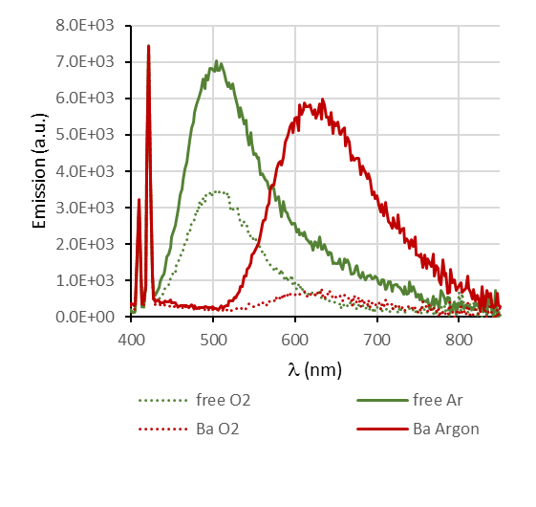
Comparison free-bound under oxygen / 5 min argon
Emission at 620 nm
1E-5 M ACN
oxygen
argon
τ₁ 4 ns (20%)
τ₂ 345 ns (80%)
χ² 0.71
τ₁ 10 ns (4%)
τ₂ 238 ns (25%)
τ₃ 768 ns (71%)
χ² 0.76
oxygen
argon
1E-6 M ACN
τ₁ 3 ns (21%)
τ₂ 470 ns (790%)
χ² 1.23
τ₁ 3 ns (1%)
τ₂ 286 ns (20%)
τ₃ 1290 ns (79%)
χ² 1.15
ZFFL55_19&20_9_2023
ZFFL55 03_10_2023
EPL375_TCSPC_50KHz_20ms, 1024 channels, 30 min

